Slide 1
Greens Ledge Light Preservation Society

Slide 2
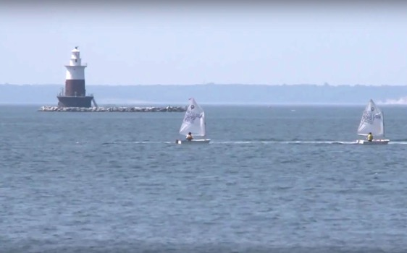
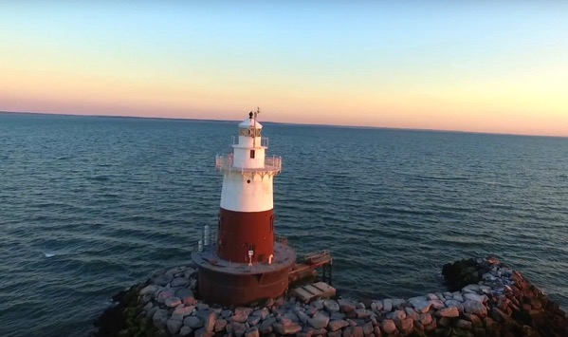
Greens Ledge Light
A Historic Icon of Coastal Connecticut & Our Local Community
Greens Ledge Light is a historic icon of the gritty and tenacious culture of coastal Connecticut.
Located less than a mile from shore and towering seven stories above the water, the lighthouse has become an awe-inspiring symbol of the local Rowayton and Darien community.

Slide 3
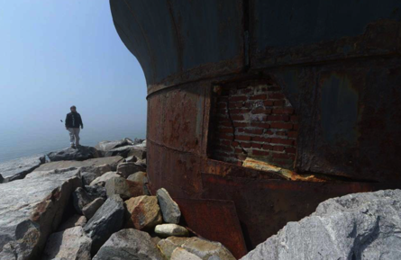
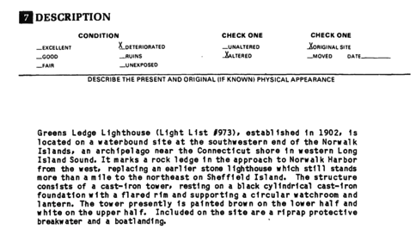
The Problem
Greens Ledge Light Is In Need of Immediate Restoration Work
Decades of neglect and recent storms have threatened to erase this historic emblem forever.
Green’s Ledge Light is currently listed as in “Deteriorated” condition by the National Register of Historic Places, just one level above “Ruins.”
Structural engineers have determined that in its current condition, there is significant risk that Greens Ledge could be destroyed in another major storm event.
Significant restoration work needs to be done to keep Greens Ledge Light standing.

Slide 4
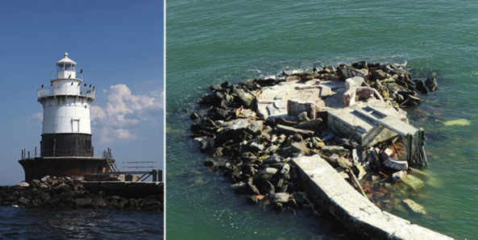
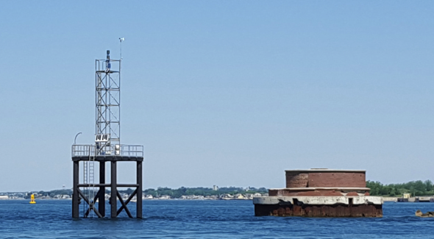
The Problem
Case Study: Old Orchard Light & Deer Island Light
Old Orchard Light, an identically constructed lighthouse in New York, tragically collapsed during Hurricane Sandy. Deer Island Light, another identical lighthouse in Boston Harbor, was dismantled after local restoration efforts failed to raise enough funding.
Old Orchard Light, New York
Deer Island Light, Boston

Slide 5
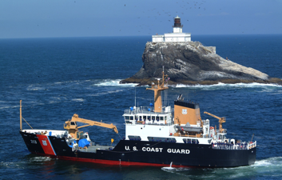
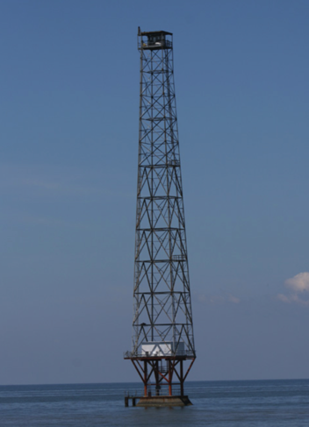
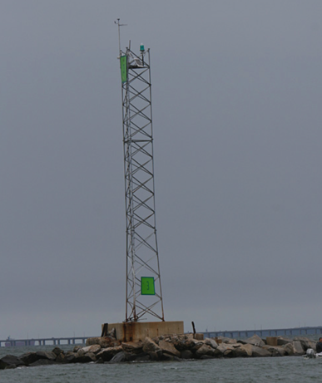
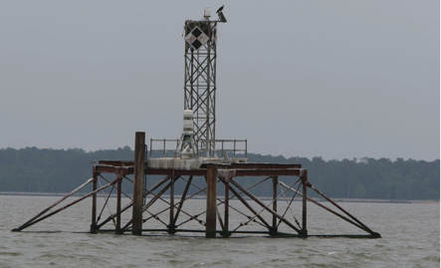
The Problem
Greens Ledge Light Is In Need of Immediate Restoration Work
Like Greens Ledge, these were active lighthouses, critical infrastructure maintained by the US Coast Guard. Their collapse required the constructed tall metal “skeleton tower light beacons, a structure similar to a cell tower.

Slide 6
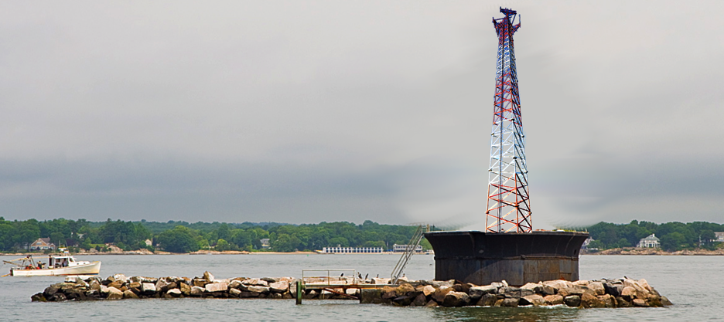
The Problem
Greens Ledge Light Is In Need of Immediate Restoration Work
By all indications, if Greens Ledge were to structurally fail, a tall metal “skeleton” light tower could be built in its place, forever impairing the view of Long Island Sound from Rowayton and Darien.
*Rendering

Slide 7
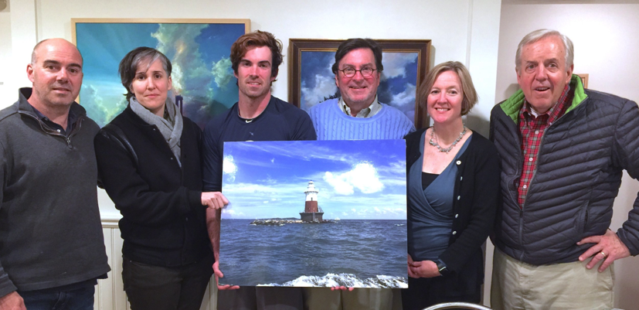
Our Organization
The Greens Ledge Light Preservation Society is a 501(c)3 nonprofit organization based in Rowayton, Connecticut. Our Board is composed of lifelong local residents and passionate stewards who have been inspired by this historic lighthouse.
Board Members Tim Pettee, President
Peter Tombros Brendan McGee Todd Robbins Alicia Sullivan Shannon Holloway Alex Pettee
Development Committee
Tim Pettee
Todd Robbins
Shannon Holloway
Alicia Sullivan
Mailing Address
Greens Ledge Light Preservation Society
PO Box 43
Rowayton, CT 06853
SaveGreensLedge.net
SaveGreensLedge@gmail.com
Tim Pettee: (203) 939-9654
Construction Committee
Brendan McGee
Alex Pettee
Frank Mullaney

Slide 8
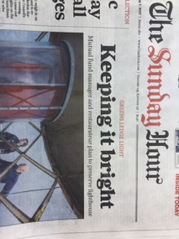
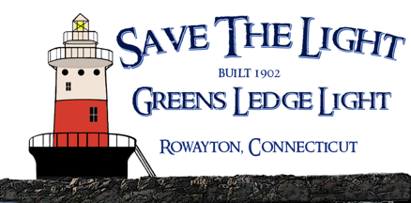
Our Mission
Our Mission is to Save, Protect, and Preserve Greens Ledge Light
Greens Ledge Light Preservation Society formed in 2016 in response to Greens Ledge being put up for auction through the National Historic Lighthouse Preservation Act program.
We acquired the lighthouse at auction and became a qualified 501(c)3 nonprofit organization. The purchase was funded through a founding donation by The Pettee Family, lifelong Connecticut residents.

Slide 9
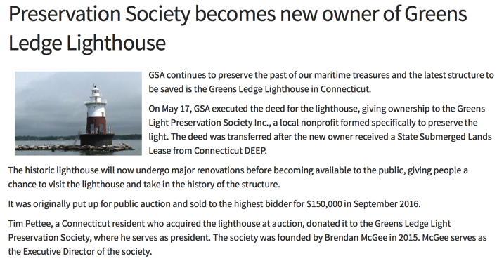
Phase 1: Acquisition
Objective: Acquire lighthouse from GSA, secure rights to underwater lands from State of Connecticut
COMPLETED

Slide 10
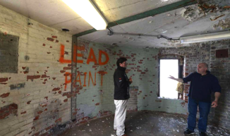
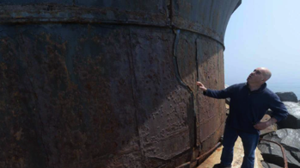
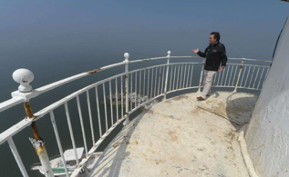
Phase 2: Structural Stabilization & Exterior
Objective: Restore Structural Integrity of the Lighthouse’s Caisson and Lower Deck
1 | SURVEY TO OWNER | 7/7/2017
No. | DESCRIPTION | DATE
ISSUED DRAWINGS
NOTES:
14
15
16
17
14
15
16
17
MASONRY WALL BELOW
MASONRY WALL BELOW
13
18
13
18
12
HATCH (TYP X3)
COMPASS ROSE
W12X
T8X
T8X
19
12
19
W12X
W12X
CISTERN OPENING
11
W12X
20
11
20
GREENS LEDGE LIGHTHOUSE
T8X
T8X
T8X
DOWN LADDER
SUBSTANTIAL CRACKING
DOWN LADDER
10
T8X
21
10
21
T8X
T8X
NORWALK, CT
9
T8X
OPEN FOR STAIR
22
9
22
T8X
SURVEY RESULTS DRAWINGS
T8X
T8X
8
T8X
T8X
23
8
23
T8X
T8X
T8X
DOOR
FRAMING PLANS
7
W12X
W12X
T8X
24
7
24
SCALE:
As indicated
6
1
SUBSTANTIAL CRACKING
6
1
PROJECT NUMBER:
16114
DATE:
05/26/2017
DRAWN BY:
JJS
5
4 3
2
5
4 3
2
CHECKED BY:
S1
AJ / JFN
₂ DECK FRAMING PLAN
₃ DECK PLAN
1/4" = 1'-0"
1/4" = 1'-0"

Slide 11
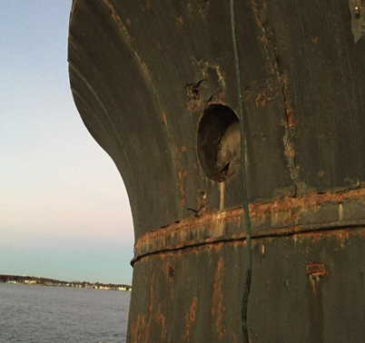
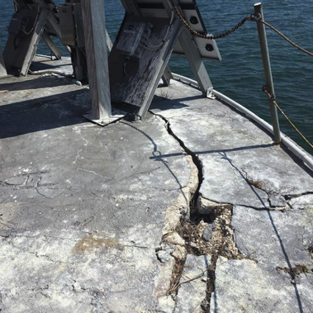
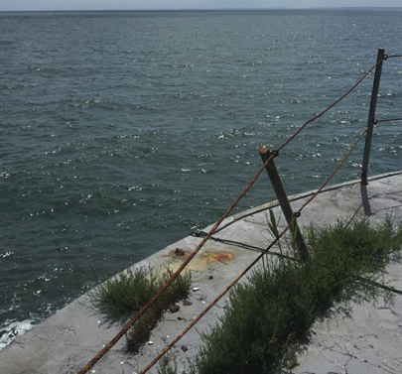
Phase 2: Structural Stabilization & Exterior
Objective: Restore Structural Integrity of the Lighthouse’s Caisson and Lower Deck

Slide 12
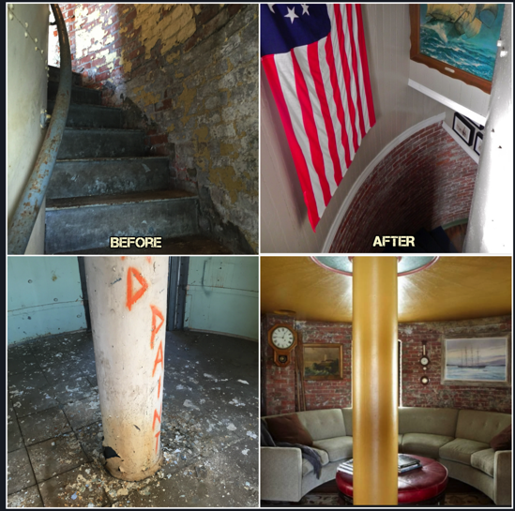
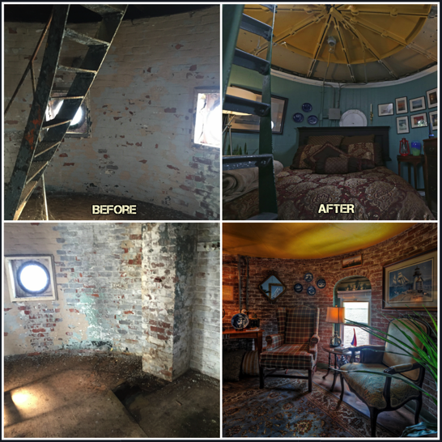
Phase 3: Historical Restoration
Objective: Maximize the Functionality of Green’s Ledge Through A Historically Authentic Interior & Exterior Restoration

Slide 13
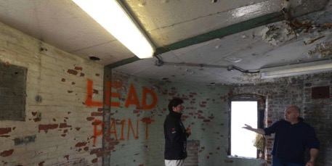
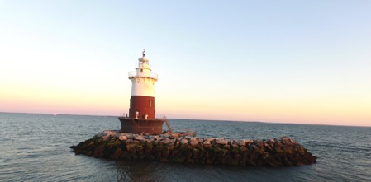
“The Next 100 Years” Vision of Greens Ledge
Transforming The Lighthouse Into A “Living” Multi-Generational Asset
For the past 100 years, Green’s Ledge, a working aid to navigation (ATON), was completely inaccessible to the community. Like dozens of other lighthouses, it has stood as a “hollow statue” that was minimally maintained, gradually deteriorating until its inevitable demise.
Our “Next 100 Year” Vision is to break that cycle and transform Greens Ledge from “statue” into a functional asset managed by a community of invested Keepers. By bringing “life” to the property, we believe the Lighthouse will receive a far higher level of care and attention. If we can execute on this vision, we will greatly enhance the likelihood of multi-generational survivability.
“Hollow Statue” Receiving Minimal Care
“Living Asset” Receiving Highest Care

Slide 14
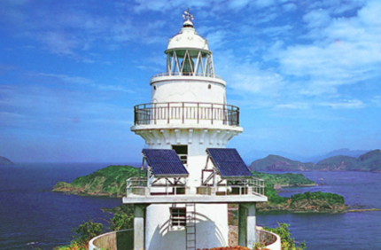
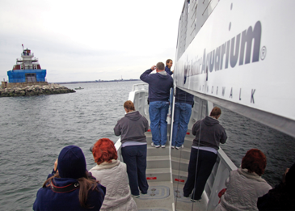
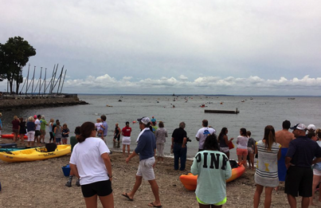
“The Next 100 Years” Vision of Greens Ledge
Benefiting The Broader Community
Leader In Environmental Sustainability
Tours & Educational Programs
Community Events
Integrate into Existing Community Events Including the Annual Lighthouse Swim, Sailing Events, and other Events that Benefit Our Local Community
Design a Sustainable Off-The-Grid Living System That Becomes a Template for Future “Green” Projects
Leverage Unique Location to Take Leadership Role in Sustainability & Environmental Studies
Partner With Existing Local Educational and Historical Preservation Programs
Allow The Public to Tour The Lighthouse For the First Time in It’s 115 Year History

Slide 15
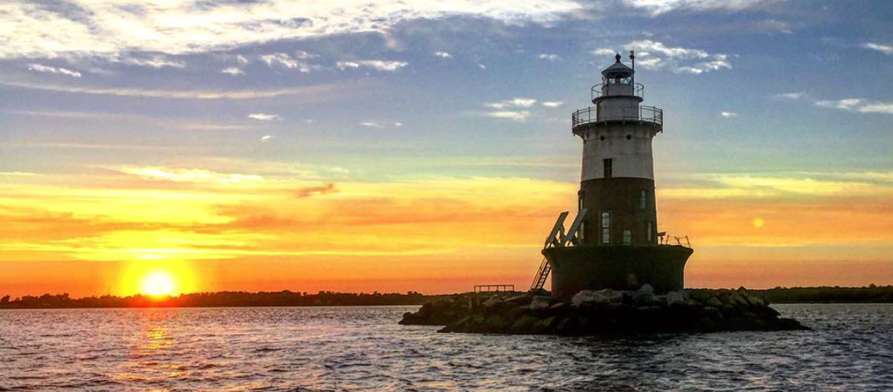
Help us Save Greens Ledge Light
Please, Become a Keeper of Greens Ledge Light.
Join us as we save this historic lighthouse for generations to come.

